Slide 1
Search
Shen Bingquan <sbingqua@dso.org.sg>
National University of Singapore :: School of Engineering :: Engineering Science Programme

Slide 2
Contents
The Search Problem
Tree Search
Graph Search
Data Structure for Search Algorithms
Search Methods
Measuring Problem-solving Performance
Blind Searches
Depth First Search
Breadth First Search
Uniform Cost Search
Heuristics Searches
Greedy Best-First Search
A* Search
Creating Admissible Heuristics
Examples

Slide 3

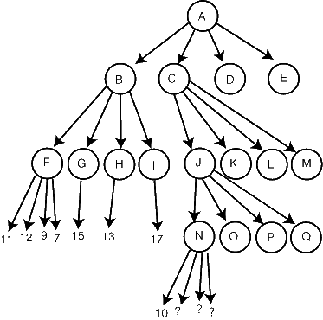
Solving Problem by Searching
Reflex Agents
Decisions based on current observed state.
Do not consider consequences of actions.
Planning Agents (Goal-based agent)
Decisions based on (hypothesized) consequences of actions.
Have a model of how the world evolves in response to actions.
Work towards its goal state.

Slide 4
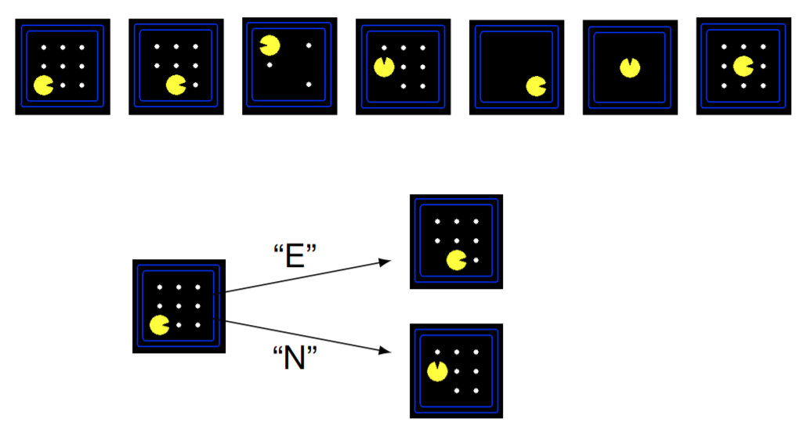
Search Problem
State Space
Successor Function (with action and costs)
Start and Goal State
Solution: sequence of action (a plan) from start state to goal state

Slide 5
The Search Tree
Breath (Branching Factor)
State Space
Successor Function (with action and costs)
Depth
(# edges)

Slide 6
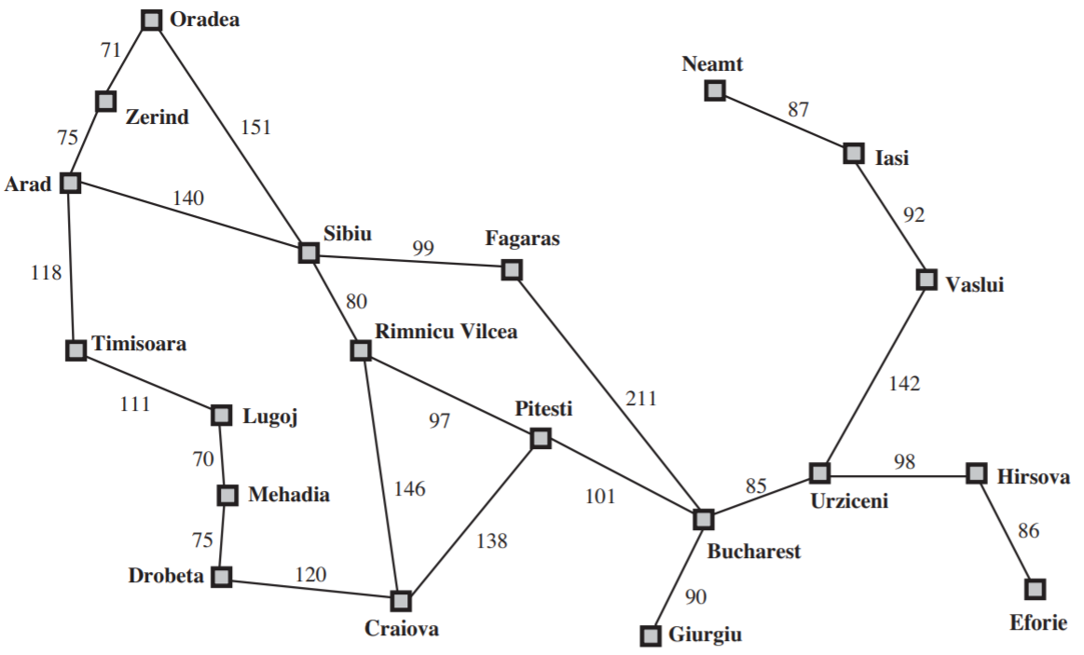
Path to Bucharest (Abstraction)
State space: In(city)
Start State: In(Arad)
Successor Function:
Actions: Roads between cities
Cost: Distance
End Test: In(Bucharest)
Solution?

Slide 7
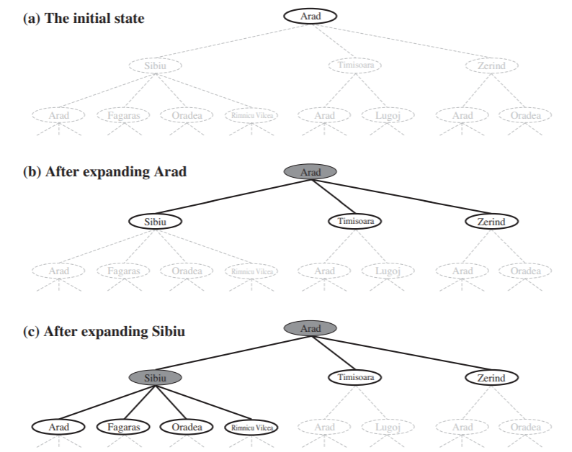
Tree Search
Root Node
Exploration of state space by generating successors of already-explored states.
Every states is evaluated: is it a goal state?
leaf nodes

Slide 8
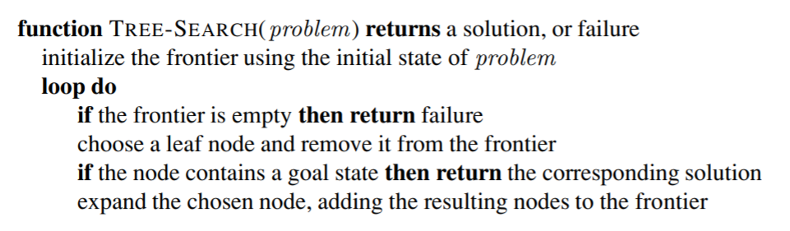
Tree Search Algorithm
The set of all leaf nodes available for expansion at any given FRONTIER point is called the frontier (Many authors called it the open list).
Expanding nodes on the frontier continues until either a solution is found or there are no more states to expand.

Slide 9
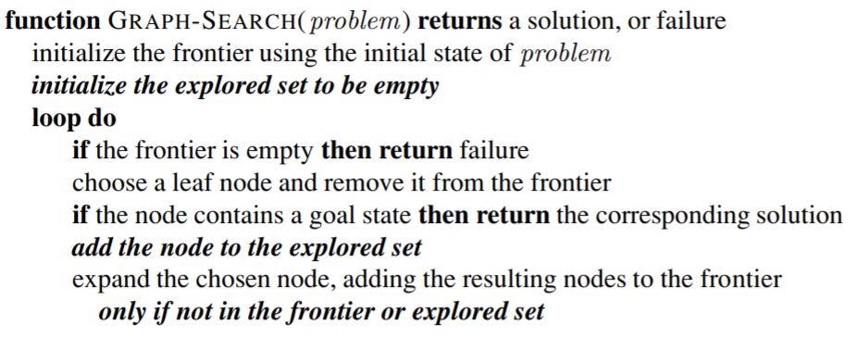
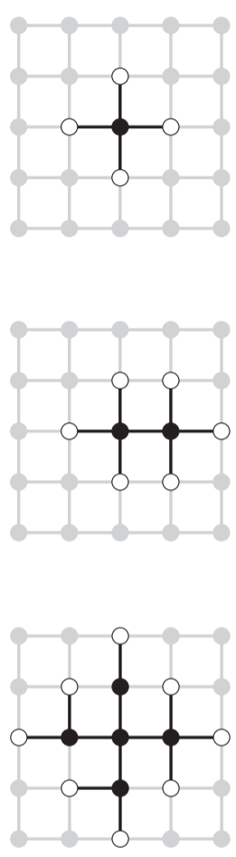
Graph Search Algorithm
Some paths generate repeated states (redundant paths).
Need a explored list (closed list) to remember every expanded node.

Slide 10
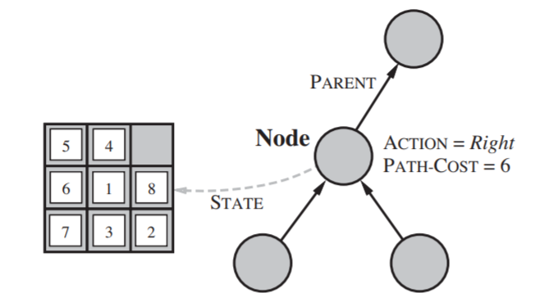
Data Structure for Search Algorithms
Search algorithms needs to keep track of the search tree that is being constructed.
Each node n of the tree contains FOUR components:
n.STATE: the state in the state space to which the node corresponds
n.PARENT: the node in the search tree that generated this node
n.ACTION: the action that was applied to the parent to generate the node
n.PATH-COST: the cost of the path from the initial state to the node
8-Puzzle state

Slide 11
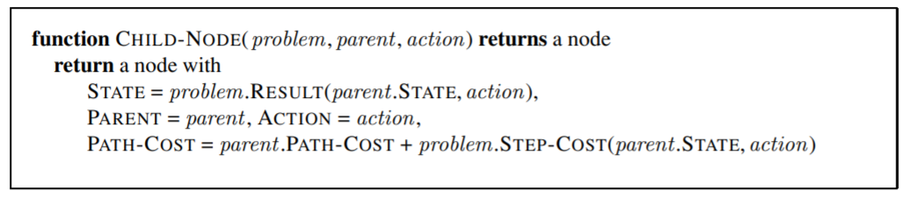
Data Structure for Search Algorithms
Given the components for a parent node, components of child node could be found by:
When a goal node is found. The SOLUTION is obtained by following parent pointers back to the root.
Note the difference between STATES and NODES.

Slide 12
Search Methods
How to search? Which nodes in Frontier to expand first?
Blind Search
Depth First Search
Breadth First Search
Uniform Cost Search (Dijkstra's algorithm)
And more ...
Heuristics Search
Greedy Best-First Search
A* Search
And more ...
http://www.cs.nott.ac.uk/~pszgxk/courses/g5aiai/003blindsearches/blind_searches.htm
Notes:
Blind search means that the strategies have no additional UNINFORMED SEARCH BLIND SEARCH information about states beyond that provided in the problem definition. All they can do is generate successors and distinguish a goal state from a non-goal state. All search strategies are distinguished by the order in which nodes are expanded.
Strategies that know whether INFORMED SEARCH one non-goal state is “more promising” than another are called informed search or heuristic HEURISTIC SEARCH search strategies;

Slide 13
Measuring Problem-solving Performance
Completeness: Is the algorithm guaranteed to find a solution when there is one?
Optimality: Does the strategy find the optimal solution (The path with lowest cost among all solutions)?
Time complexity: How long does it take to find a solution?
Space complexity: How much memory is needed to perform the search?

Slide 14
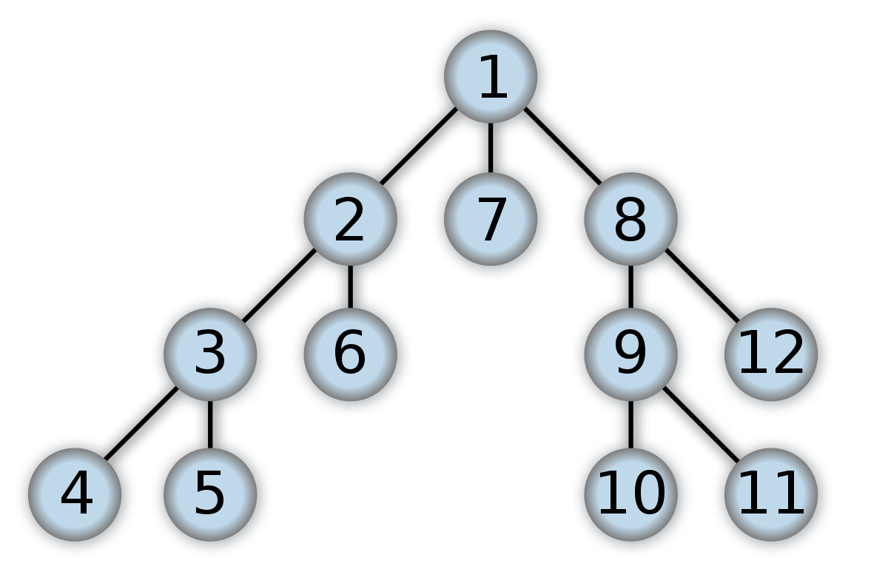
Depth First Search
Expands the deepest node in the current frontier.
Access Frontier like a LIFO stack.

Slide 15
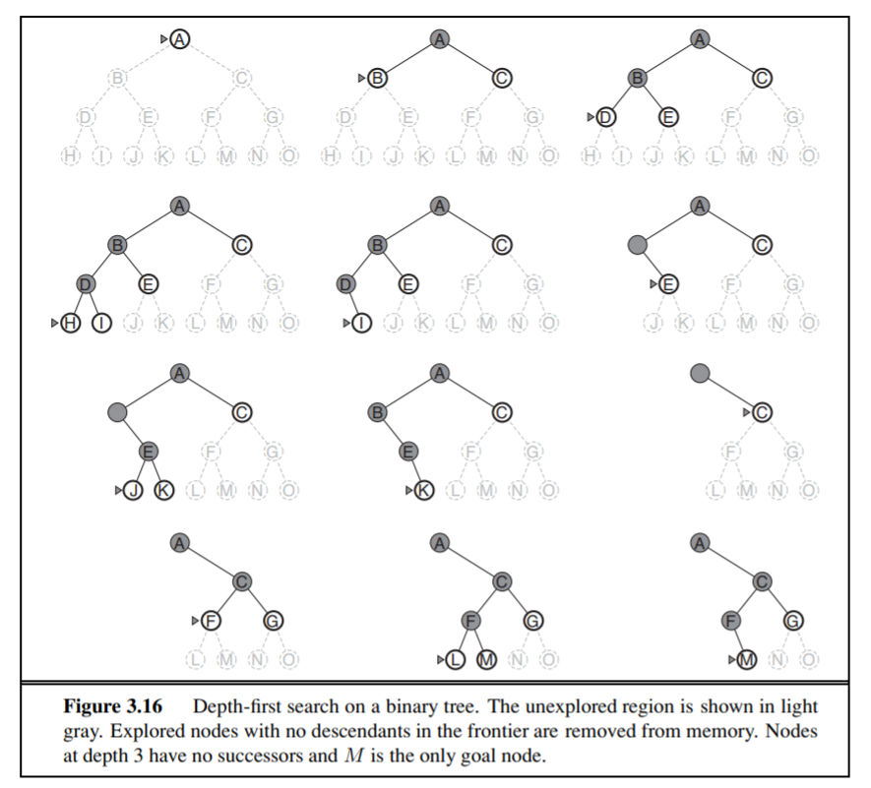
Depth First Search
Completeness: Yes (only for graph-search) Infinite loops in Tree-search
Optimality: No.
Time complexity: O(b^{m}) nodes m - max depth of any node b - branching factor
Space complexity: O(bm) nodes Once a node has been expanded, it can be removed from memory after all its descendants have been fully explored.

Slide 16
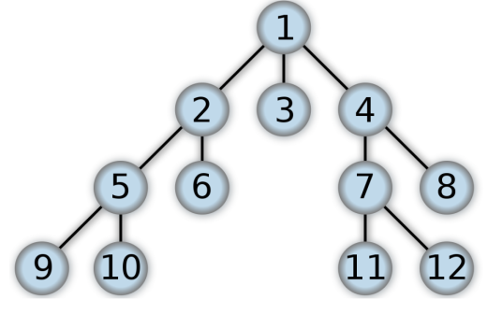
Breadth First Search
Expands the Shallowest node in the current frontier.
Access Frontier like a FIFO stack

Slide 17
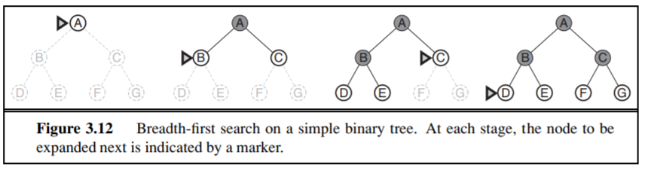
Breadth First Search
Completeness: Yes, it is complete. :)
Optimality: No. Only optimal if the path cost is a nondecreasing function of the depth of the node. (e.g. same cost for all actions)
Time complexity: b + b² + b³ + ··· + b^{d} = O(b^{d}) nodes b – branching factor d – depth of solution
Space complexity: O(b^{d}) nodes :( Dominated by the size of the frontier.

Slide 18
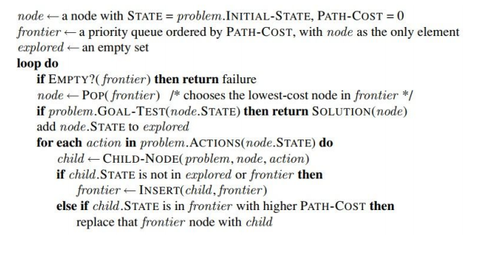
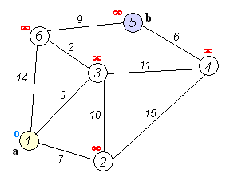
Uniform Cost Search (Dijkstra's algorithm)
Expands the node with the lowest path cost, g(n).

Slide 19
Uniform Cost Search
Completeness: Completeness is guaranteed provided the cost of every step exceeds some small positive constant. :)
Optimality: Yes. Uniform-cost search expands nodes in order of their optimal path cost. :)
Time and Space complexity: O(b^{1+C*/𝝐}) where b - branching factor, C* - cost of the optimal solution, 𝝐 - cost of every action
When all step costs are the same, UCS is similar to BFS, except that the latter stops as soon as it generates a goal, whereas UCS examines all the nodes at the goal’s depth to see if one has a lower cost; thus UCS does strictly more work by expanding nodes at depth d unnecessarily.

Slide 20


Other Blind Searches
Depth-limited Search
Iterative Deepening DFS
…
No information on goal state.

Slide 21
Heuristics in Search
Heuristic Function, h(n), estimated cost of the cheapest path from the state at node n to a goal state.
How close is a state is to a goal?
Problem dependent.
For now, consider h(n) to be arbitrary, nonnegative, problem-specific functions, with one constraint: if n is a goal node, then h(n)=0.

Slide 22
Greedy Best-First Search
Expands the node that is closest to the goal, given by heuristic, h(n).
Evaluation function, f(n) = h(n)
What could possibly go wrong?

Slide 23
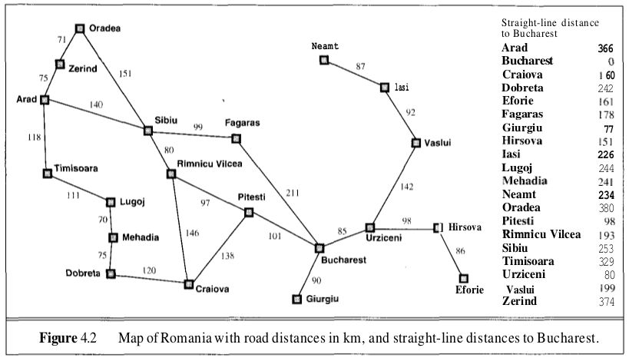
Expanded nodes
Is it Optimal?
1
2
450
418
3

Slide 24
Greedy Best-First Search
Completeness: Incomplete for tree-search even in a finite state space. Complete for graph-search.
Optimality: No.
Time and Space complexity: Worst case O(b^{m}) nodes m - max depth of any node b - branching factor
Complexity can be reduced substantially with good heuristics.

Slide 25
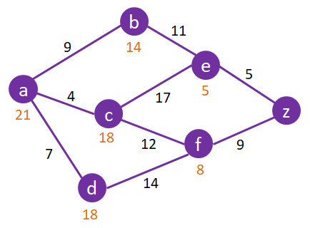
A* Search
Combination of g(n), the cost to reach the node, and h(n), the cost to get from the node to the goal.
f(n) = g(n) + h(n)
Estimated cost of the cheapest solution through n.
Start
Goal

Slide 26
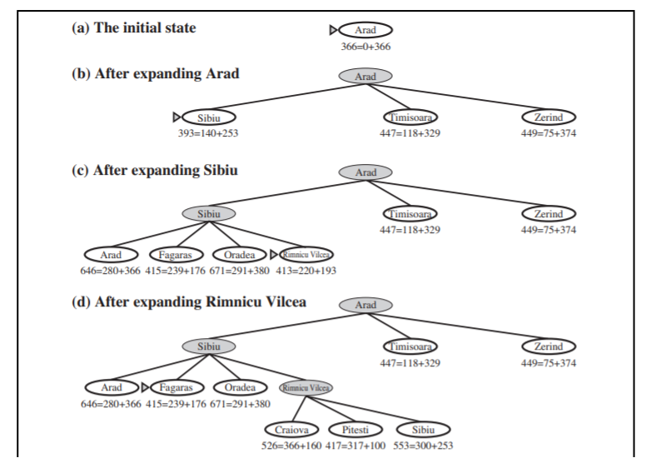
A* Search
f(n) = g(n) + h(n)

Slide 27
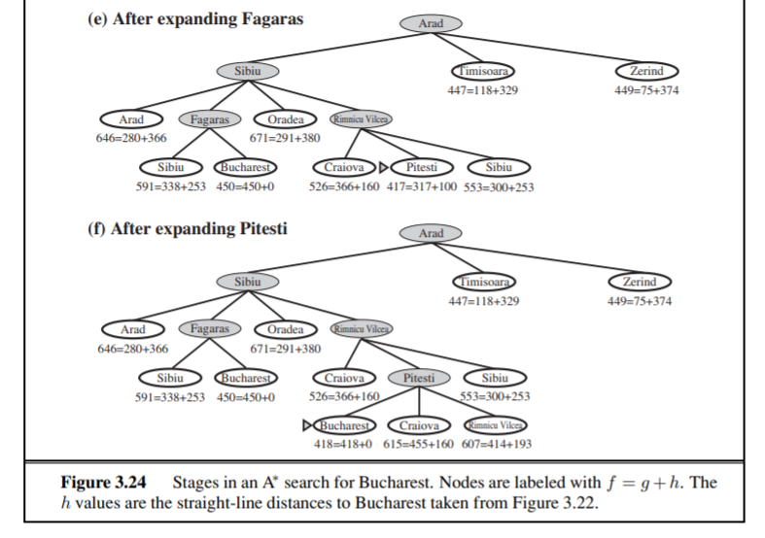
A* Search

Slide 28
A* Search
h(n’)
n’
g
h(n)
c(n,a,n’)
Both Complete and Optimal. Two conditions for optimality:
Admissibility: h(n) is admissible if it never overestimates the cost to reach the goal. Nature optimistic because they think the cost of solving the problem is less than it actually is.
0 ≤ h(n) ≤ h*(n)
Is the straight-line distance to Bucharest heuristic admissible?
Consistency: h(n) is consistent if for every node n and every successor n’ of n, the estimated cost of reaching the goal from n is no greater than the step cost of getting to n’ plus the estimated cost of reaching the goal from n’:
h(n) ≤ c(n, a, n’) + h(n’)
Every consistent heuristic is also admissible.
n

Slide 29
A* Search
Time complexity: For constant step costs, O(b^{𝝐d}) b - branching factor
𝝐 - relative error of heuristics, (h∗ − h) / h∗
d - solution depth
Space complexity:
O(b^{d})
Impractical to insist on finding an optimal solution, variants to find suboptimal solutions quickly.

Slide 30
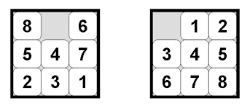
Creating Admissible Heuristics
Generating admissible heuristics from relaxed problems.
(A problem with fewer restrictions on the actions)
h₁ = the number of misplaced tiles
The score if tiles could move to their intended destination in one step
h₂ = the sum of the distances of the tiles from their goal positions.
The score if we moved each tile in turn to its destination.
8-Puzzle

Slide 31
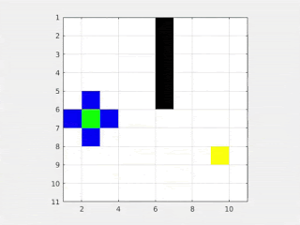

Search in Action
Uniform-Cost Search
A* Search

Slide 32
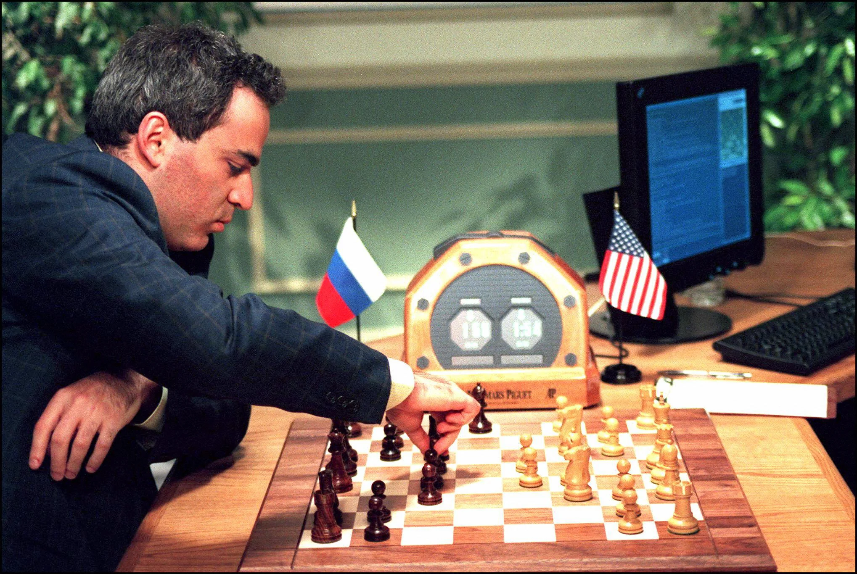
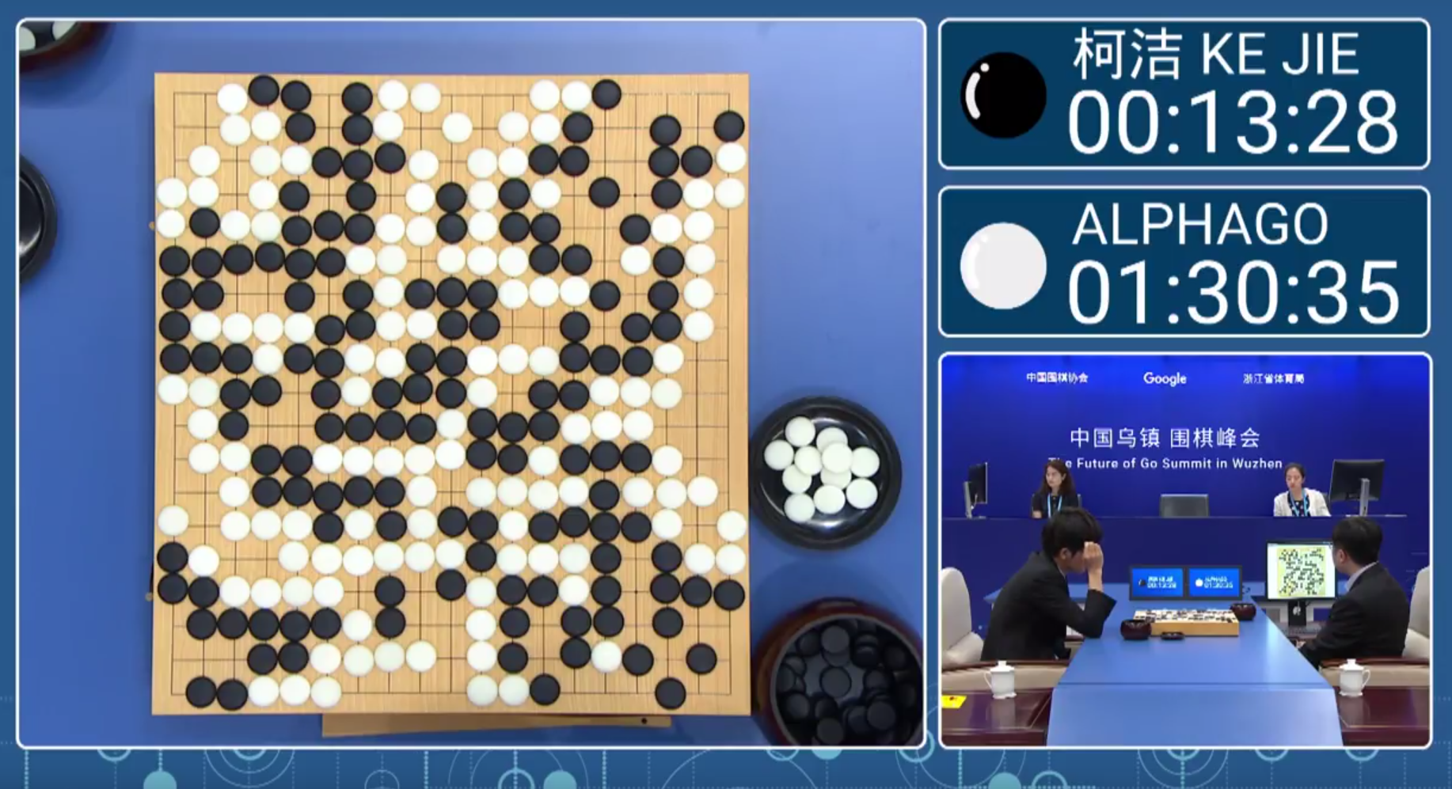
Other Search Applications
Deep Blue, IBM (1996)
AlphaGo, DeepMind (2015)
Limited Depth Alpha-Beta Search
Monte-Carlo Tree Search

Slide 33
References
https://courses.cs.washington.edu/courses/cse573/17wi/slides/02-search.pdf
https://inst.eecs.berkeley.edu/~cs188/sp20/assets/lecture/lec-2.pdf
https://ocw.mit.edu/courses/electrical-engineering-and-computer-science/6-034-artificial-intelligence-fall-2010/syllabus/
https://www.youtube.com/watch?v=uImx6dEPBbA Prof. Pieter Abbeel: CS 188 | Introduction to Artificial Intelligence (Lecture 3)
http://theory.stanford.edu/~amitp/GameProgramming/AStarComparison.html

